Slide 1
Behaviour Management
No one child has the right to be disruptive so as to prevent you from teaching or other children from learning or having fun.

Slide 2
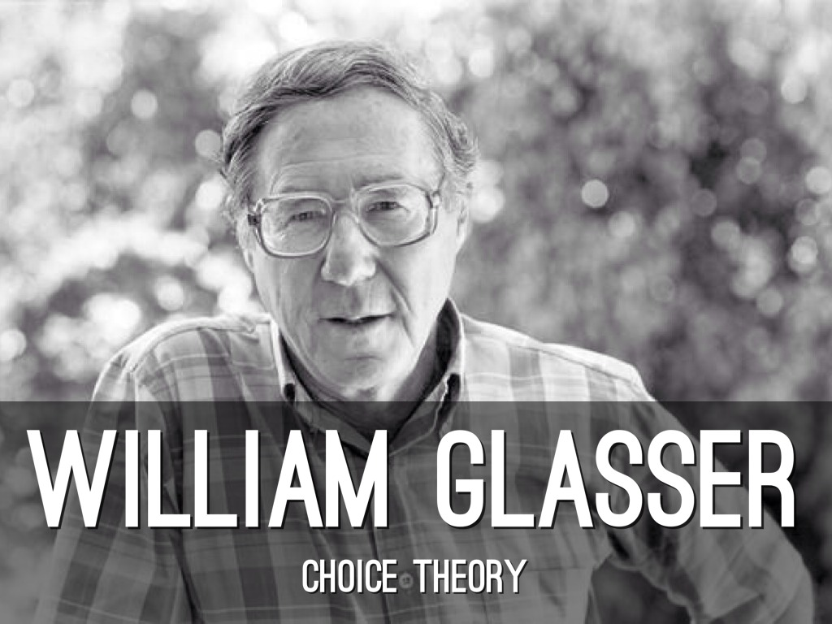
Glasser – Choice Theory
Dr. William Glasser is a psychiatrist, well known in the fields of education and social sciences.
all of our behaviour is simply our best attempt to satisfy one or more of the 5 basic needs built into our genetic structure.
The Five Basic Needs
Survival
Freedom/Choice
Personal Power (Success/Recognition)
Love, belonging, friendship
Fun

Slide 3
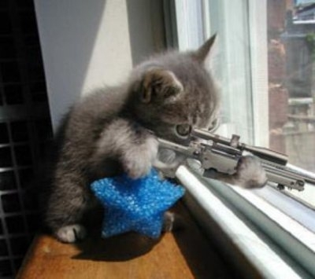
People are different … what suits some …
Drives others mad
Physical
Boys need to move more than girls Generalisation
ADHD / related issues
Mental
Short attention spans
Colouring suits some, not others
Craft suits some not others
Acting suits some and not others

Slide 4
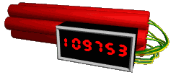
Why do they loose it ?
Is my session doing what it should ?
Am I engaging them helpfully ?
Am I engaging them age – appropriately ?

Slide 5
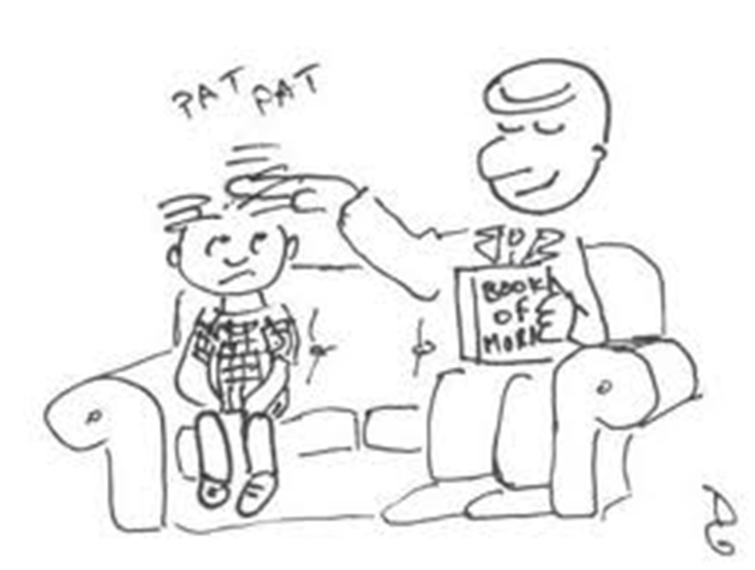
Is my session doing what it should ?

Slide 6
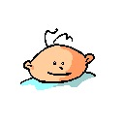
Be Interesting
Attention span
Age appropriate
Rainy days
Additional needs

Slide 7
Be Flexible
Read how long you have got in the body language
Change the pace of things if attention wavers
Change the activity if we need a wriggle

Slide 8
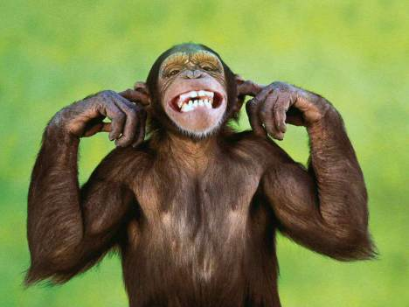
Be clear
Give clear instructions
Never talk over the top of other children.
Ensure you have attention when starting.
Don’t offer choices unless you mean to
“We don’t do that here”

Slide 9
Be Relational
Know your children.
Take a personal interest in them.
Learn and remember their names.
Build caring relationships with them.
Pray for them.
Establish rapport
Sit someone next to them, sit there yourself.
Eye contact.
Your presence is often enough to influence the behaviour.

Slide 10
Be Subtle
Positive Reinforcement. It’s easy to forget
Don’t respond only to negative behaviour.
Ask a question of the child, related to the program.
A gentle touch on the shoulder.
Use a gesture e.g. clicking finger to get immediate attention and to indicate the change of behaviour required.
A short, clear request directed at the child for the behaviour to cease.
Use the child’s name and maintain a normal tone of voice. Return to the flow of your program as quickly as possible.
Have adults strategically placed among the children primed to do all this

Slide 11
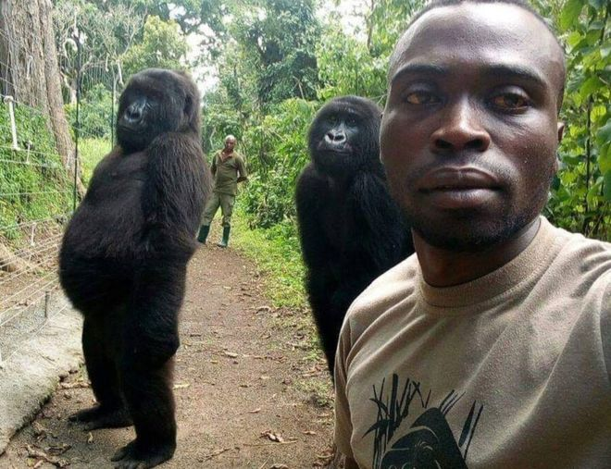
Be Consistent
Children need
to see justice
being the
same for all.

Slide 12
Be firm
Time out. For many children their actions reveal their need to be noticed, so this might be beneficial
But don’t use it to reward bad behaviour
… in this case, make it boring !
Withdrawing privileges – have a list of possible things up your sleeve
Involve the parents.
If you say that you are going to ring
the parent/s … DO IT

Slide 13
Behaviour Policy

Slide 14
Remember … overall … you are in control … you have to be
If you loose that control, children will not enjoy it, not learn …
A child may well take control instead

