Slide 1
Children & gender fluidity
Olly Goldenberg

Slide 2
Crazy Times?
Notes:
School in Brighton has 76 children who identify as non-binary gender.
All girls school where one transitions to boy.
Use of public toilets.
People in prisons.
Transgenders in sports.
Have we already had the first female president of the United States?
Rebranding in Clark’s shoe shop
The boy in the dress – David Walliams
Leading to Kids turning up to school in dresses because school uniform does not allow them to ditch their trousers in the heat.
Human reproduction requires a male and a female (XY and XX genetic markers for male and female). It is binary. Kleinfelter’s syndrome (XXY).
Transgender is not a problem with body it is in the thoughts (thoughts and feelings can be factually wrong or correct). A delusion is a fixed false belief. E.g. anorexic, “I am thin.” Or “I am cat.” I am an amputee trapped in a body, “body dysmorphic”.
This is mental illness. Co-morbidity with other items – depression, OCD,
We don’t agree with an anorexic, careful with collusion with.
John Hopkins university hospital stopped transgender because it did not effect long term outcome. Now been silenced and they have restarted surgery.
High suicide rates found in transgender people pre-op. Around 40%. High suicide rates found in transgender people postop.
It is a delusion.
“I am a boy in a girl’s body.”
Dissociation between body and mind. We are created as one person.
Tom boy girls - Effeminate boys.
Both okay.
Male or female.
Otherwise identify as an animal (otherkin) or identify as a different age such as Dutch man Emile Ratelband.

Slide 3
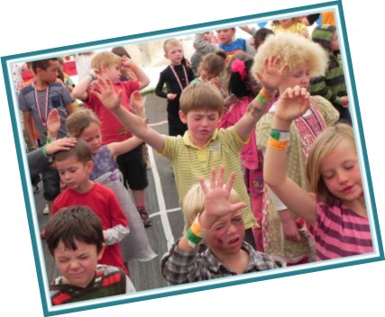
My focus
Notes:
My focus is to prepare a generation to live in these times – so the focus on this seminar is not so much on how we interact with those struggling with gender identity, but more on how we can prepare a generation to live in a society where binary gender of male and female is no longer seen as being fixed from birth.

Slide 4
Frameworks
Ministerial
Pastoral
Theological
Notes:
Theological framework is our foundation and comes from the Bible. Pastoral cannot dictate theology, but theology instructs pastoral.
E.g. sin leads to eternal separation from God is a difficult theology, but increases the urgency of us reaching out to those who don’t yet know God. We don’t change theology to suit our feelings, but theology is our very foundation.

Slide 5
Theological framework
Notes:
Genesis 1:27
Everybody is made in God’s image.
God made us male and female.
Galatians 3:28
“Neither male nor female,” meaning this identity no longer holds the same importance as our identity in Christ – not that we can choose our gender, but that our gender does not give us greater standing. We are all equal in God’s kingdom. Newest believer, to the highest leader in the church.
John 3:16
Everyone is special to God.
Romans 3:23
We are fallen creation, but though not perfect we are all able to approach God through Jesus.
Hebrews 11
By reason of use are able to discern right from wrong. Must be steeped in God’s word to stand in these days.

Slide 6
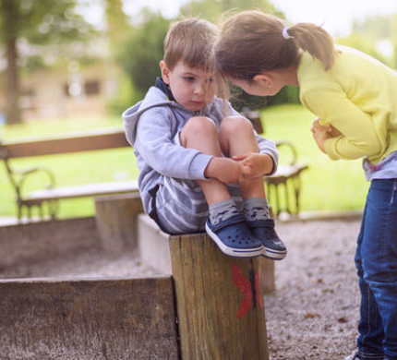
Pastoral framework
Notes:
Love everyone. Every person faces struggles – who are we to judge one struggle over another. All are loved to God.
Those who are being discipled, must continually point them to Christ as their identity.
Our children need the tools to be able to discern right from wrong.
Meat teaching is required. Hebrews 5:11-6:3 BY REASON OF USE ARE ABLE OT DISCERN.

Slide 7
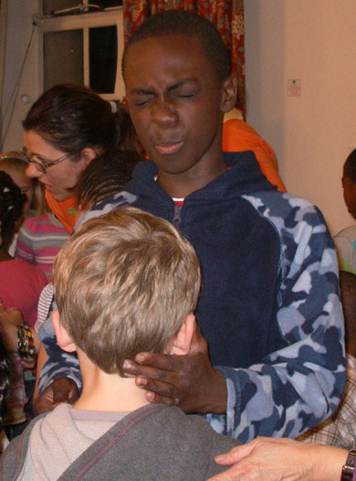
Ministerial framework
Notes:
2 Timothy 4:1-5 preach the gospel, in the last days people will listen to whatever their ears believe and turn to myths.
In wanting to see our children grow into their full potential with God, we realised that a huge part of this includes them discovering their identity in Christ. This is an ongoing part of any discipleship that appears through much of our teaching, but it provides a great forum for discussing our gender in a wider context of our purpose. Here are some of the themes that we keep returning to as we help children to discover their own identity.
God does not make mistakes. He did not make a mistake when he put you on earth at this time (think of Esther who was there for such a time as this). He did not make a mistake when he made you male or female. God put you here to fulfil his plan.
The power of a name/label. God named many people in the Bible and changed the names of many others to reflect their new identity in him. Famously, Jabez also asked God to ignore his name and grant him a fresh identity.
We are made in God’s image. We are called to reflect something of God’s goodness and glory here on earth.
What we worship we will become like (see Psalm 115:3-8 and 2 Corinthians 3:18). As we worship God we become like his image (how he created us to be). When we worship an idol, we become like it (less than God’s best for our lives).
God has a plan for us to fulfil. This area includes both the general plan that God has for every believer and the specific calling he has for each individual.
Our life fulfilment comes not from following our own desires, but from pursuing our life purpose which is only fully found when we desire God above everything else.
Included in this teaching are opportunities for ministry that look at where our perceived identity does not match God’s view of us. Perhaps by words spoken over us from others (labels given) or through lack of faith. Further opportunities are given to seek God for our unique callings and to share testimonies about the impact of choosing to follow God even above our own desires.

Slide 8
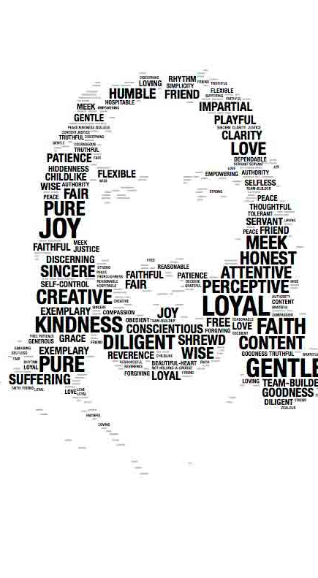
Identity
Notes:
Ministering on identity used to be the priority of youth leaders, in this world today we must make this a priority for ministry to our younger children also.
One young teen used to wear layers of makeup and a heavy attitude. After teaching on identity and a time of ministry she arrived at the next meeting makeup-free and smiling. The rest of the group wee stunned by the transformation in her as they could see she now had peace. She went on to explain how God had shown her she was beautiful on the inside and so she no longer felt the need to wear the makeup.
Celebrate who you are and how God has made you!
Our identity is Christ.
Discussion – how else we can minister identity to our children.

Slide 9
Want to read more?
sexchangeregret.com Walt’s website.
www.transgendertrend.com Concerned parents researching transgender in the UK.
www.mermaidsuk.org.uk Support children who are questioning gender.
Notes:
Websites cover those who are concerned for changes in school and those who are promoting these changes. Here you can find more info.

